Slide 1
Week 4 Lab 3 web2
Dr : Rasha
Eng : Gehad Mustafa

Slide 2
Superglobals
Super global variables are built-in variables that are always available in all scopes.
$GLOBALS
$SERVER
$REQUEST
$POST
$GET

Slide 3
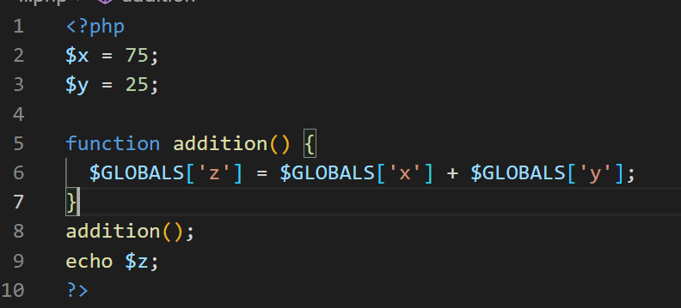

$GLOBALS
$GLOBALS is a superglobal variable used to access global variables from anywhere in the PHP program. PHP stores all global variables in an array called $GLOBALS[index] → The index holds the name of the variable.

Slide 4
$_SERVER
$_SERVER is a PHP super global variable which holds information about headers, paths, and script locations.
$_SERVER['REMOTE_ADDR'] | Returns the IP address from where the user is viewing the current page
$_SERVER['REQUEST_METHOD'] | Returns the request method used to access the page (such as POST)
$_SERVER['SCRIPT_NAME'] | Returns the path of the current script
$_SERVER['PHP_SELF'] | Returns the filename of the currently executing script

Slide 5
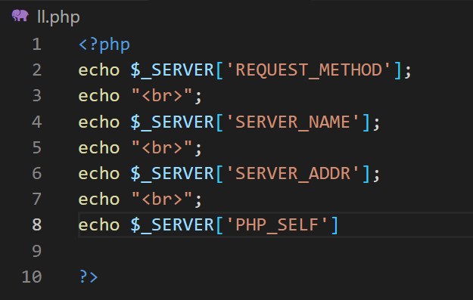
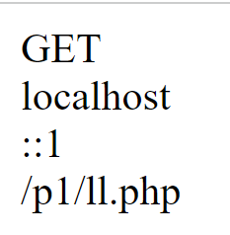
$_SERVER
$_SERVER is a PHP super global variable which holds information about headers, paths, and script locations.

Slide 6
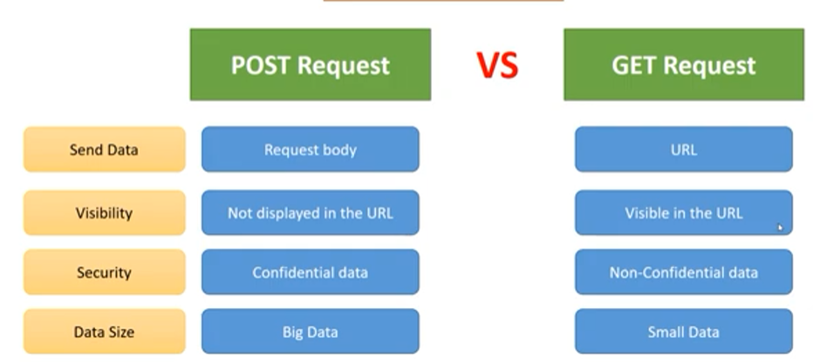
GET vs POST

Slide 7
$_GET
The Hypertext Transfer Protocol(HTTP) Get method is mainly used on the client (Browser) side to send a request to a specified server to get certain data or resources.
Using this method the server should only let us receive the data and not change its state. Hence it is only used to view something and not to change it.
The Get method is one of the most used HTTP methods.
The request parameter of the get method is appended to the URL. Get request is better for the data which does not need to be secure.

Slide 8
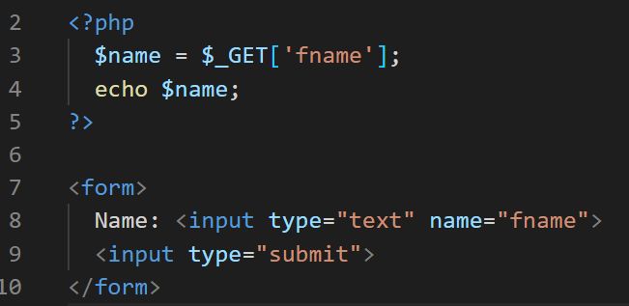
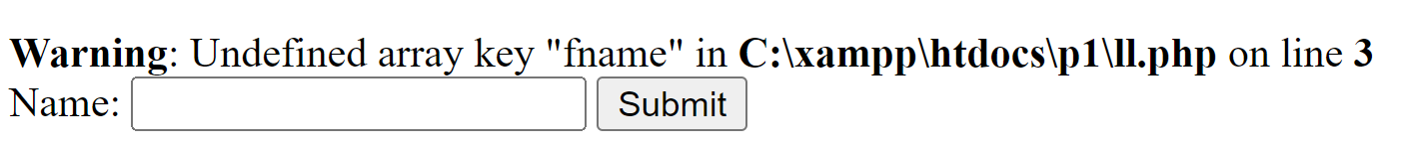
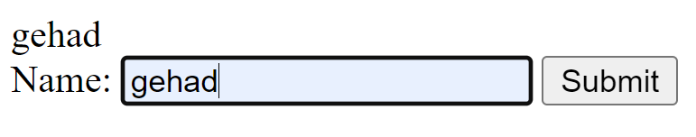
$_GET

Slide 9
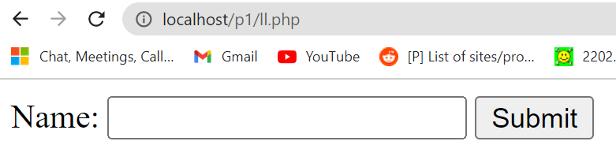
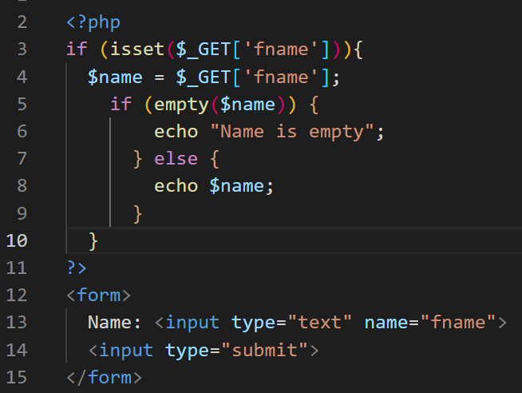
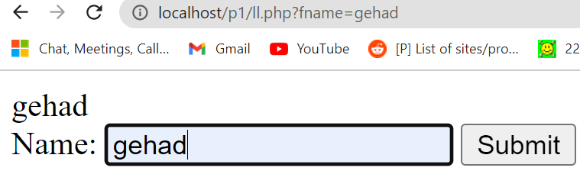
$_GET
isset() Function Check whether a variable is empty. Also check whether the variable is set/declared:

Slide 10
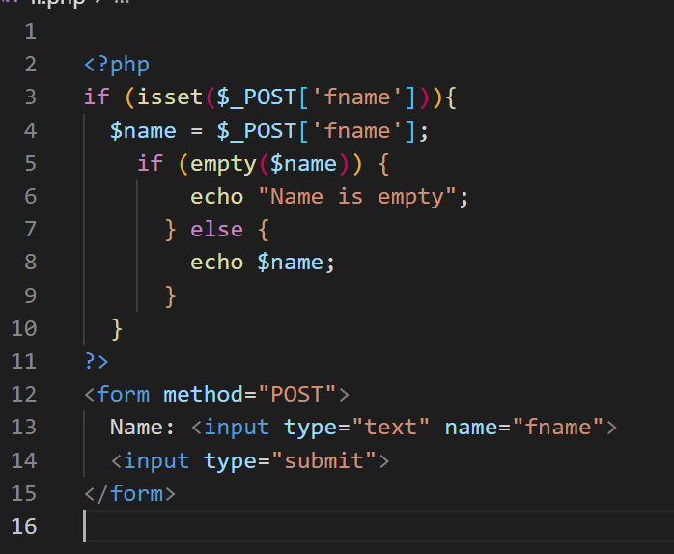
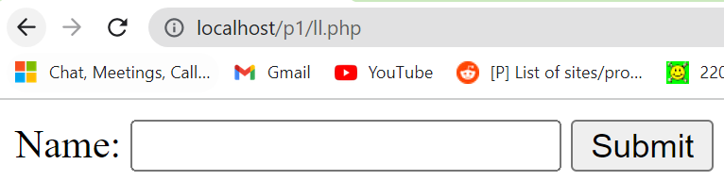
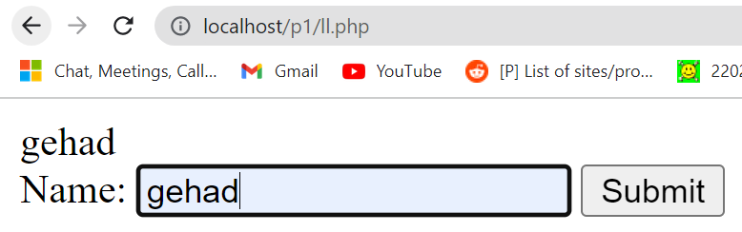
$_POST

Slide 11
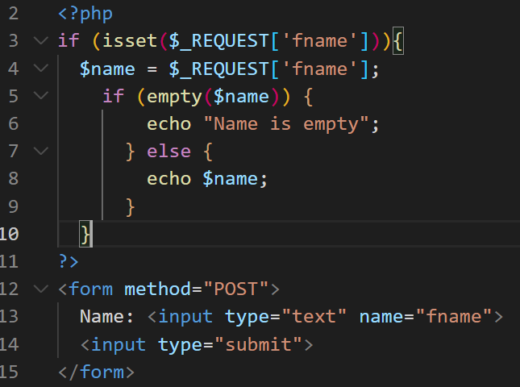
$_REQUEST
$_REQUEST is a PHP super global variable which contains submitted form data, and all cookie data.
In other words, $_REQUEST is an array containing data from $_GET, $_POST, and $_COOKIE.

Slide 12
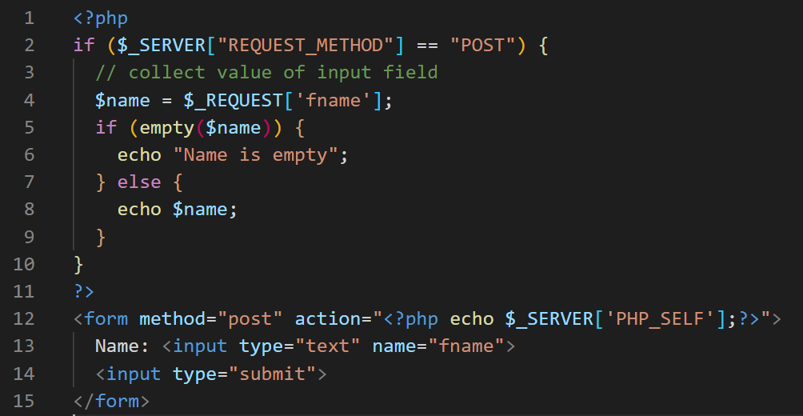
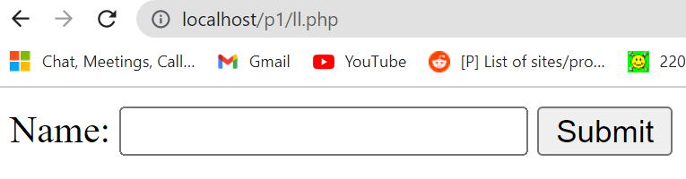
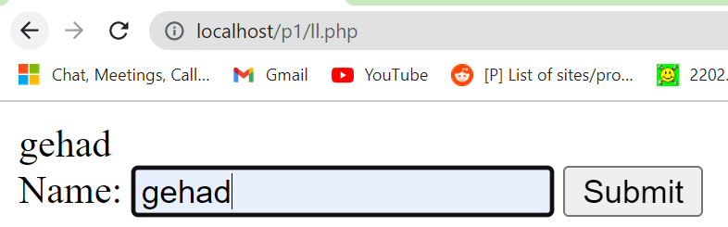
Action

Slide 13
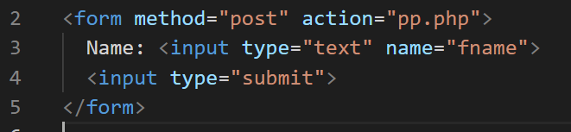
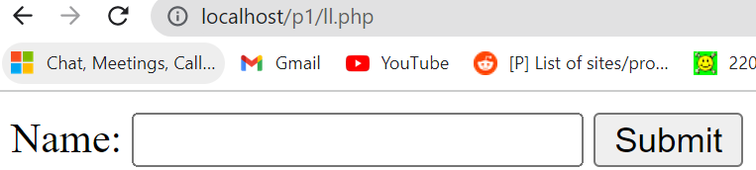
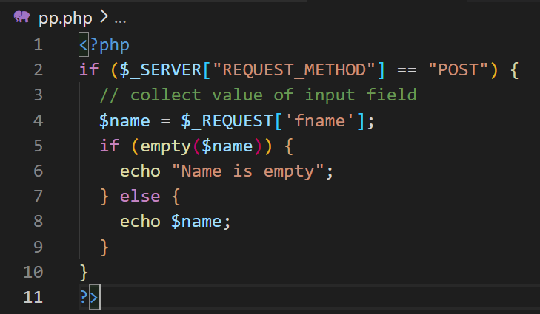
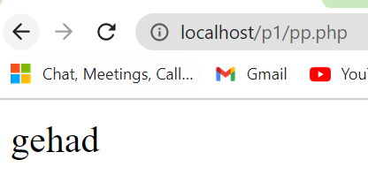
Action

Slide 14
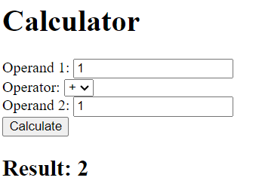
Try 1
Try to write a php program to make a calculator and then concatenate it with front end by using post method and action.

Slide 15
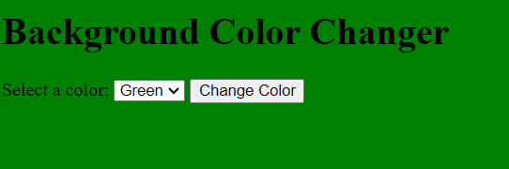
Try 2
Try to write a php program to change the background color of the homepage by user selection.

Slide 16
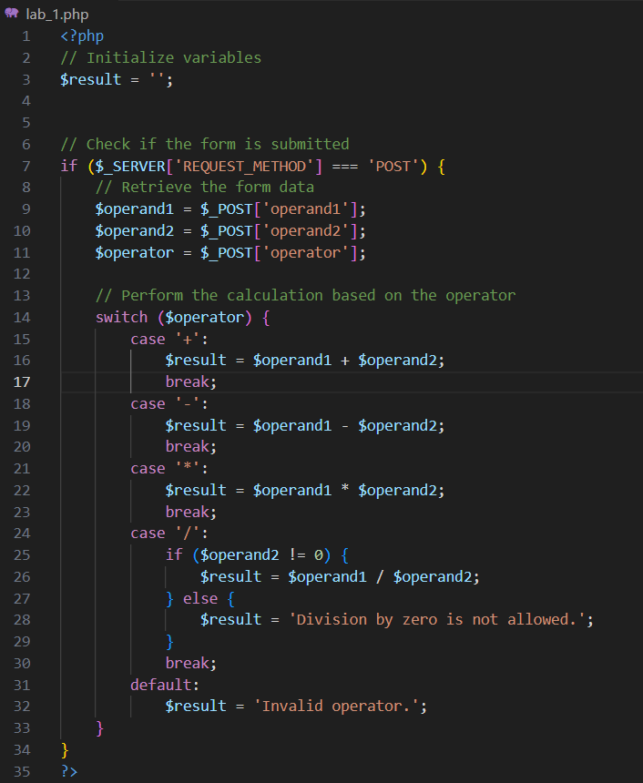
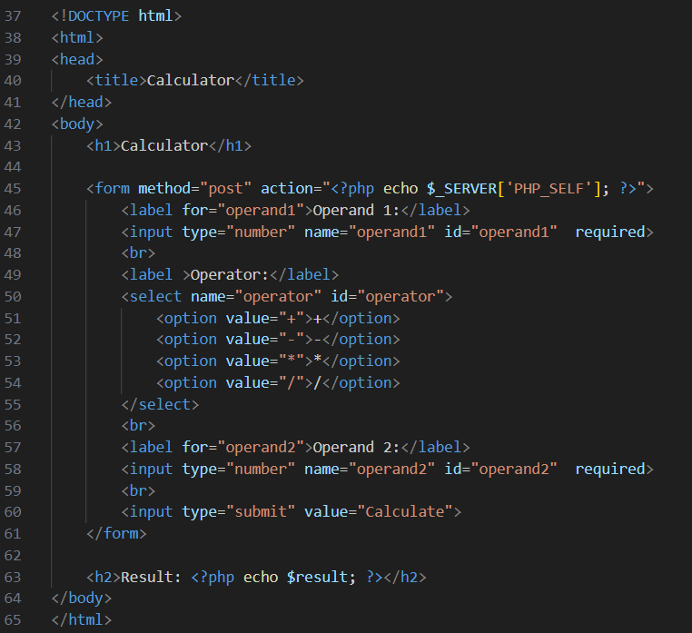
Try 1

Slide 17
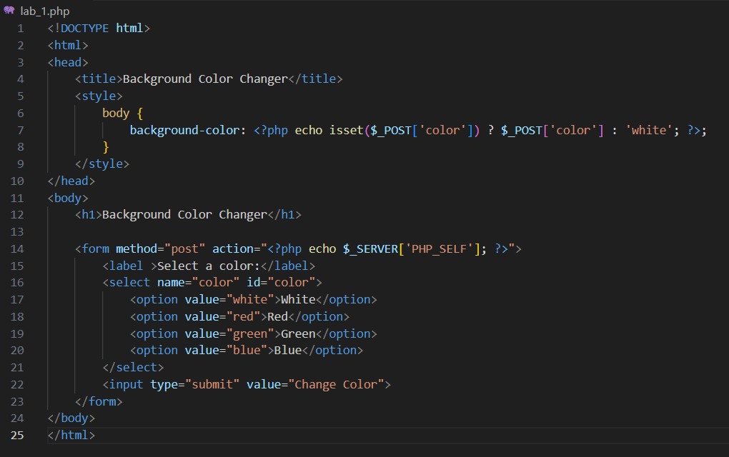
Try 2

